Slide 1
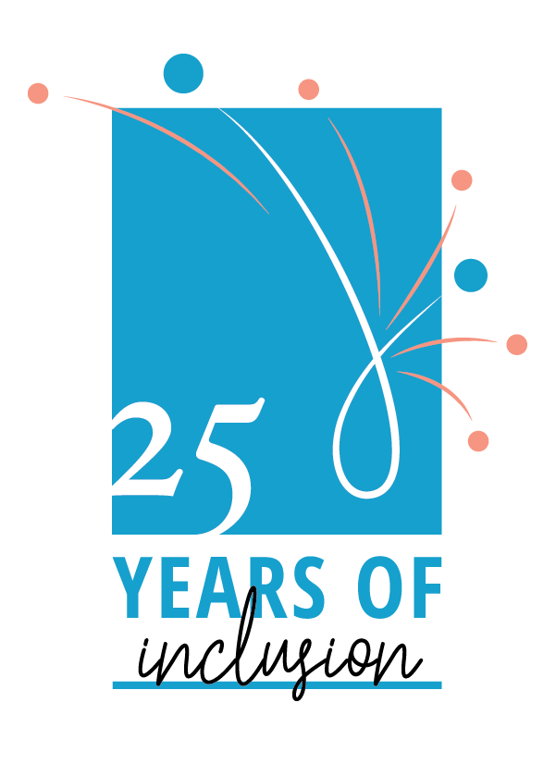
Accessible Graphic Design
Lisa Liskovoi,
Inclusive Designer and Web Accessibility Specialist
May 16th, 2019

Slide 2
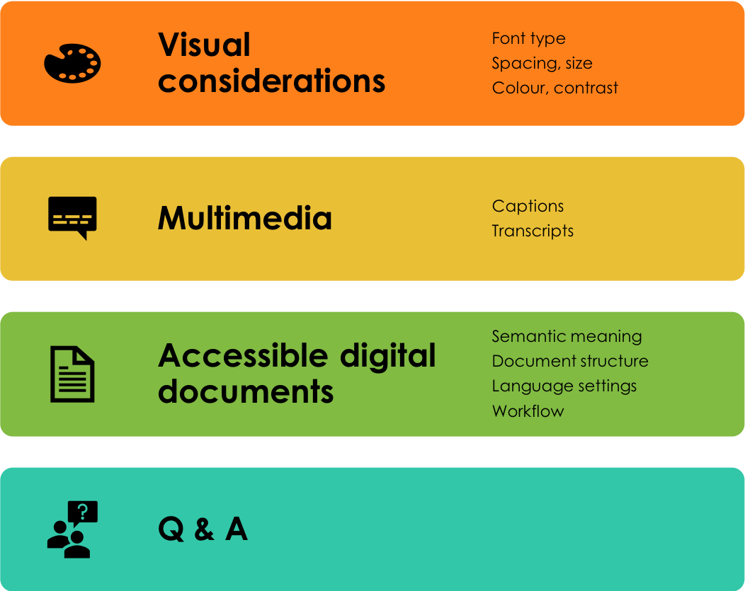
AGENDA
Notes:
Let’s start off with typographic considerations

Slide 3
TYPOGRAPHY
Notes:
Let’s start off with typographic considerations

Slide 4
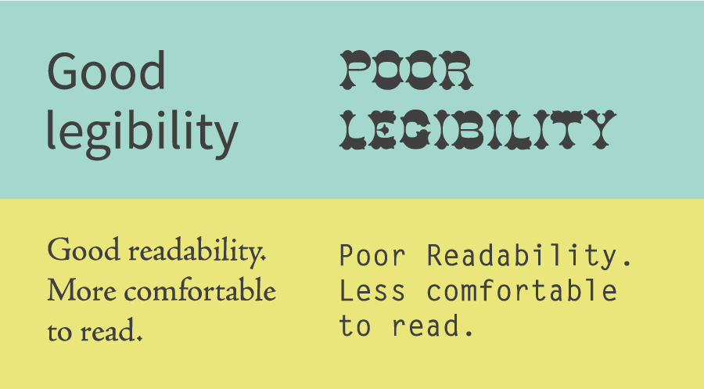
Legibility vs. readability
Image: Sadhana Jackson. Twitter @realscientists .
Notes:
Before we dive in to recommendations, I want to address a couple of terms that are particularly important for accessibility.
Legibility = ease of distinguishing each letter (sans serif fonts are often more legible): how easily you can recognize letters and tell letters apart
Readability = ease of reading words across a sentence/paragraph (serif fonts are often more readable)
https://twitter.com/realscientists/status/1027640611367780354

Slide 5
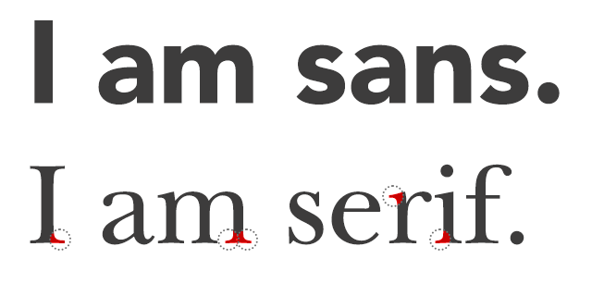
Serif vs. sans serif
Image: Sol Orwell. How Readability Can Make Sure People Actually Read Your Content.
Notes:
Serif – flourishes on the end strokes.
Sans serif – without serif. Does not have flourishes.

Slide 6
Font type
Only use sans serif fonts
It’s all about legibility and readability!
There are far more important considerations than whether the typeface is serif or sans serif.
Notes:
Only using sans serif fonts is a common recommendation: That’s actually a myth. Well, kind of. It’s a major oversimplification, and often ends up leading to the wrong results (unless you stick to Helvetica).
The important thing isn’t whether the font is serif or sans serif, it’s how legible and readable the font is, and the considerations often work in favour of sans serif fonts. However, in some cases we’ll see examples in which sans serif fonts perform worse. It’s also worth noting that although sans serif fonts tend to be more legible, serif fonts are often more readable. You should also always consider where the font will be used: print or digital, serif fonts actually tend to be more readable in print that sans serif fonts, while sans serif fonts tend to work better on screens, particularly small screens.
Serifs can improve recognition for some letters, for example Beier and Larson (2010) found that serifs on the lower case “i” improve legibility for distance viewing. Smuc et al. (2007), found that ‘a bent terminal (at the bottom of the lowercase l (el)) was of great importance to distinction.’. So serfis definitely have their place.
The reason this often gets stated is because when designing type that is readable at small sizes, like on your phone, flourishes tend to be stripped away, since they get lost if the text size isn’t big enough.
Image: 72 Font Family SAP Fiori | Design Products & Projects, Projects | Red Dot 21 https://red-dot-21.com/p/design-products/projects/72-font-family-sap-fiori/

Slide 7
Character ambiguity
Image: Nivedit Majumdar. The Magic of Fonts and Layouts
Notes:
Especially important for users with dyslexia.
Other examples of characters that are commonly confused: O and 0, B and 8, lower case a and o, q and g
Gill Sans, a fairly common and beautiful font, actually performs very poorly on this test. The three characters are virtually indistinguishable.
This can be particularly problematic when the text is not part of a word, for example in a URL. Without the context of a specific word that might provide clues to what the letter is, it can be quite difficult to figure out.
Image:https: //www.yaabot.com/5101/magic-fonts-layouts/

Slide 8
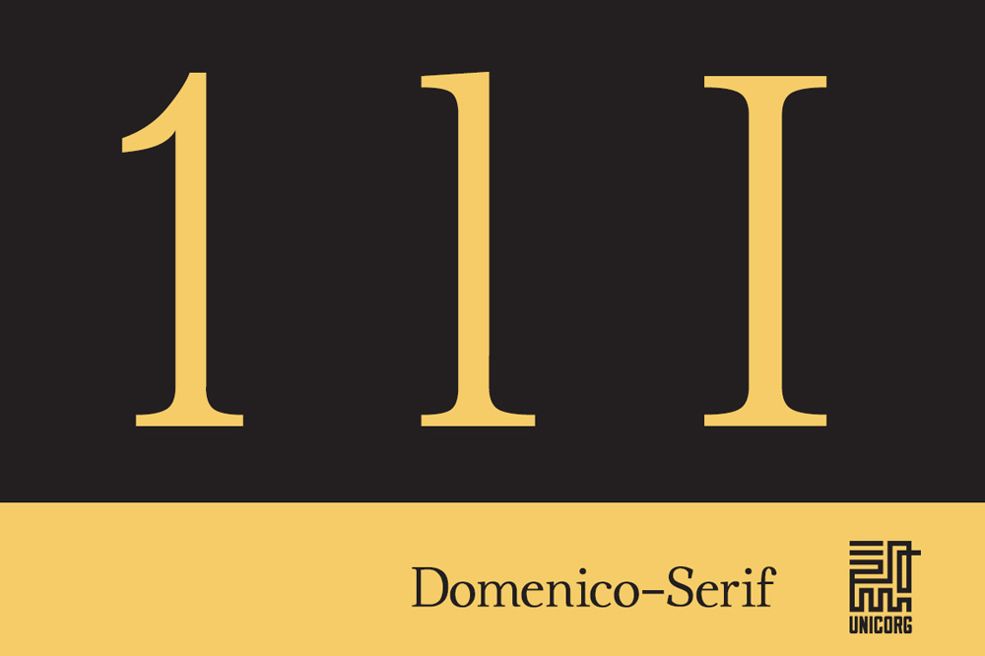
Character ambiguity
Image: Unkonwn. Creative Market.
Notes:
Despite being a serif font, Domenico-Serif performs very well on this test, with clear, clean characters that are easily distinguishable from one another.

Slide 9
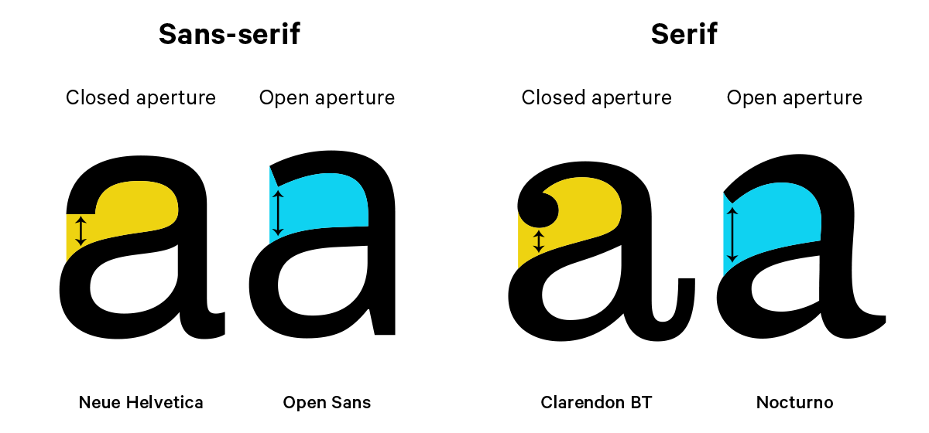
Open apertures and counters
Image: Martin Silverant. What is an aperture in typography?
Notes:
The aperture is the partially enclosed negative space in some characters.
Examples: c, bottom of the lower case e,
Wider apertures make letters easier to see and recognize, small apertures, especially when presented on a small screen tend to make the letters less legible.
In this case, serif fonts often do worse than serif fonts because the serifs crowd the aperture making it more narrow, and the counter becomes smaller.
Image: https://www.quora.com/What-is-an-aperture-in-typography

Slide 10
Open vs. closed counters and apertures
Text: Counter (typography). Wikipedia.

Slide 11
Stroke width
Image: Stuart De Rozario. How to Choose and Accessible Typeface?
Notes:
Stroke width refers to the heaviness of your letters. If the stroke is too thin, letters can be difficult to see, if it’s too thick letters can be difficult to recognize.
CNIB clear print guideliens recommend a medium heaviness font.
“There is an optimal ratio between the x-height and the stroke width. To achieve maximum legibility the character stem stroke should be 17-20% of the x-height.”
For legibility, fonts with a uniform stroke tend to work better. Modern typefaces, which have a very dramatic difference between thick and thin strokes can be beautiful but very hard to read.
Image: Stuart De Rozario. How to Choose and Accessible Typeface? https://www.webdesignerdepot.com/2016/03/how-to-choose-an-accessible-typeface/

Slide 12
Stroke width: modern fonts
Notes:
Modern fonts are very commonly used in fashion publications. They have a very slick feel, but they aren’t very legible. If you try squinting at the examples on the slides, you’ll probably notice that the thin strokes become almost invisible making letters difficult to recognize.
Modern fonts were designed as display fonts. Sometimes used for body copy.
Modern typefaces work better as decorative elements, or to emphasize content that is large, or easily recognized (e.g. Vogue). Better to avoid using this type of font for information and content, especially if it’s more than a few words.

Slide 13
Rhythm and spacing
Image: Stuart De Rozario. How to Choose and Accessible Typeface?
Notes:
Tracking – the spacing between the letterforms should be evenly balanced and rhythmic to aid character recognition.
If the spacing isn’t uniform, which often happens if you justify text in columns, as you see done in newspapers, it tends to interrupt the reading flow because the eye has to adjust to different rhythms. This is one of the reasons setting text justified left, ragged right, as in this example, is recommended for readability.
If spacing is too large it will be hard to form words, if it’s too small letters can obscure each other and become hard to read. This is especially true for some fonts where combination like r and n can be read as m.
A man who would letterspace lower case would steal sheep, Frederic Goudy liked to say.

Slide 14
Rhythm in justified text
Image: Eva Diaz-Santana. Core Text. iOS Development

Slide 15
Spacing for specific characters
Notes:
In this example, the character spacing is reduced to -30, which is considered the maximum. Again, in this case if you squint, you might easily mistake the word modern for the word modem. The same is true for small screens.

Slide 16
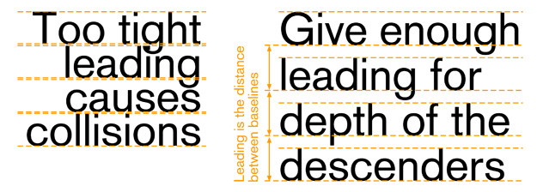
Leading
Image: Mai. Visual Aesthetics III – basics of typography
Notes:
As you’ve probably noticed by now, with pretty much all things in typography, both too much and too little can be a problem. Leading, the space between lines of text, should be large enough that the text has room to breathe, but tight enough so that it’s easy to jump from one line to the next.
A good rule of thumb is to make the leading 1.5 times the text size, so if your font size is 16pt, your leading should be 24. If you’re working with software that has fine grained control, you can be exact. If you’re working in something like Microsoft Word, you’re more likely to find proportional settings, such as “double spaced”. Which means that the leading is twice the size of the text.

Slide 17
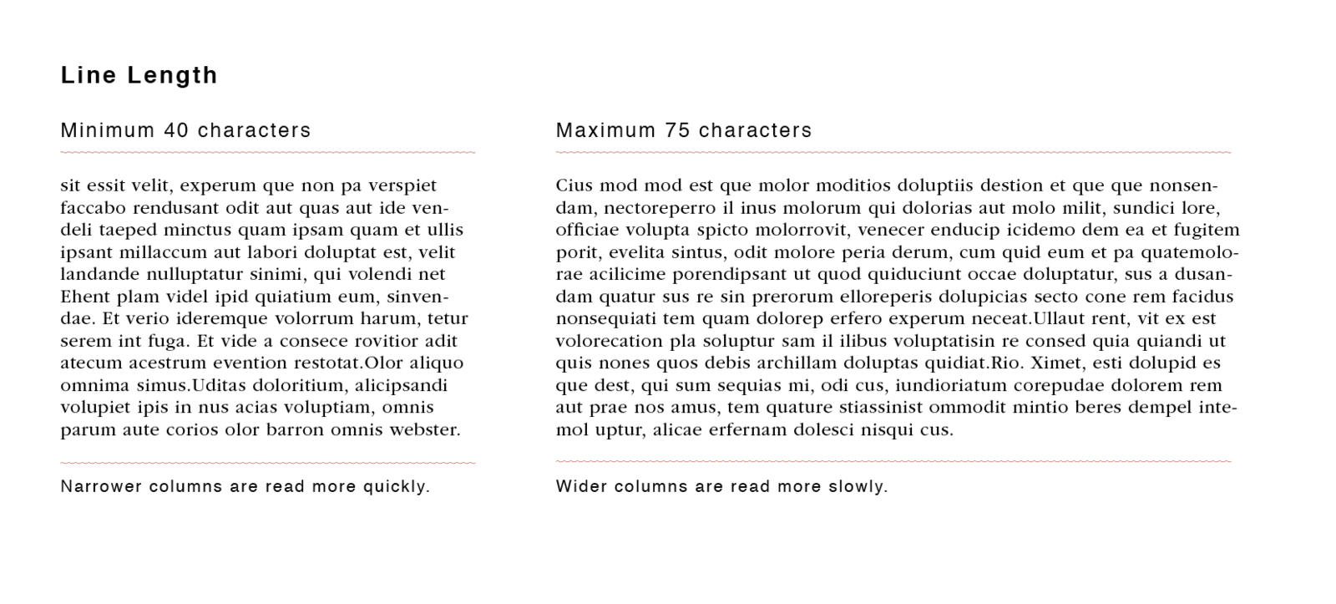
Columns and Margins
Image: Line Length. Wikipedia.
Notes:
Sorter lines are typically easier to read because it’s easier to move from one line to the next. But if the lines are too short, it will break the reading flow. If the lines are too long, it will be difficult for readers to find their spot as they move from one line to the next.
Ensure that the text isn’t crowding the edges of the page
Image: https://en.wikipedia.org/wiki/Line_length

Slide 18
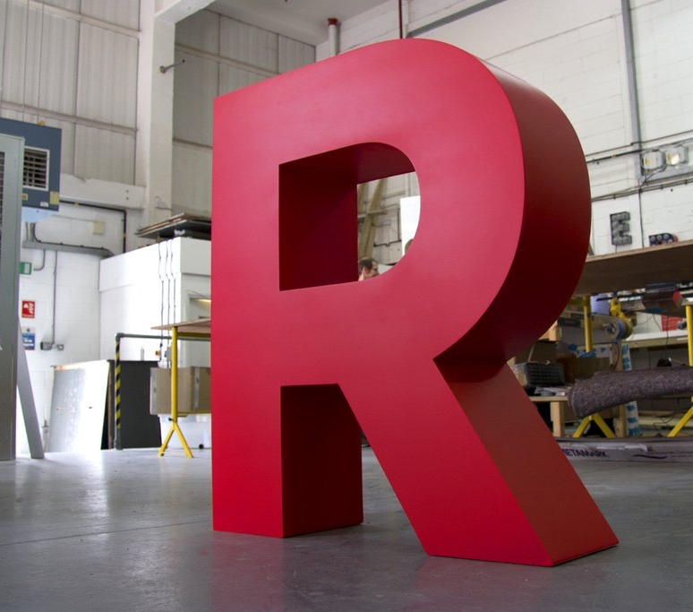
Size
Bigger is better!
For print:
12-18 points
Image: Goodwin & Goodwin. Giant Letters for Events and Festivals.
Notes:
Image: https://www.goodwinandgoodwin.com/products/giant-letters-for-events-festivals

Slide 19
Decorative fonts
Image: Coen van Leeuwen. Almost Illegible Typeface
Notes:
Great for artwork, but not for reading.
Fun Fact: Another reason people are quick to adopt the “use sans serif” rule is because serifs are sometimes considered decorative.
Image: http://coenvanleeuwen.com/projects/illegible-type.html

Slide 20
COLOUR

Slide 21
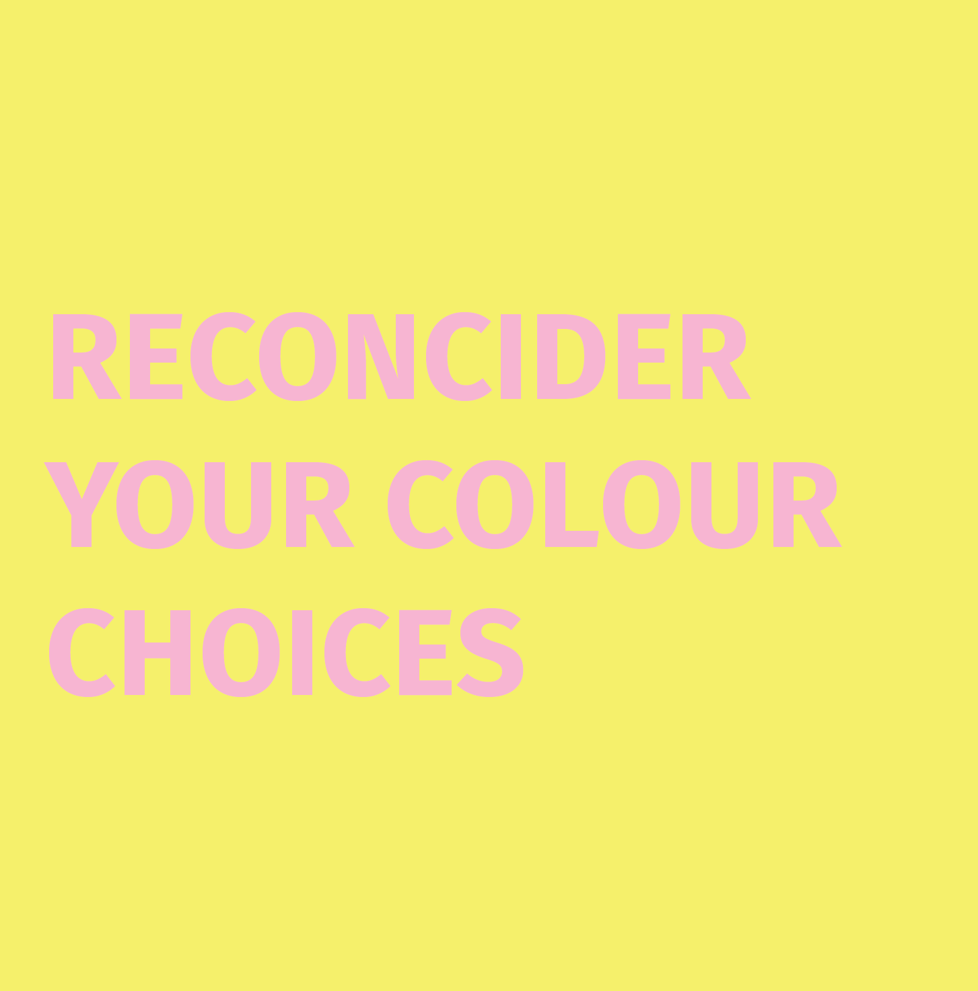
Colour contrast
High contrast between text and background.
3:1 to 4.5:1

Slide 22
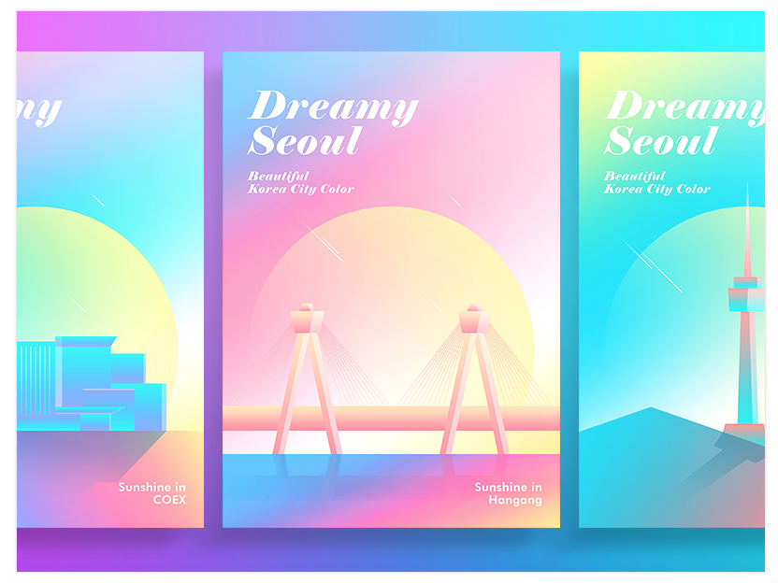
Colour contrast: gradients
Image: Dreamy Seoul by wuiett. Dribbble.
Notes:
Test the areas of lowest contrast when working with gradients.
Another tip if you want to include lighter shades in your gradients is to place the text over darker parts and allowing the lighter parts to bleed into the artwork, negative space or margins.
Question from previous workshop: "But will all internet be the same few colours in the future?"

Slide 23
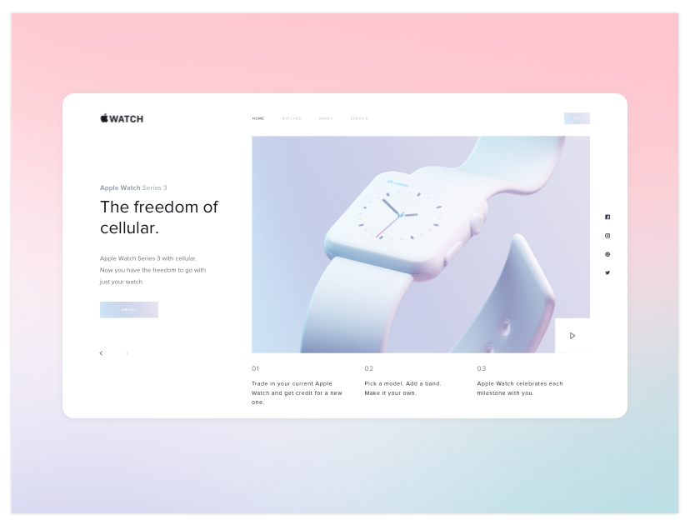
Colour contrast: it’s not what colours you use, its how you use them.
Image: Unbeliever by Ben Layton. Dribbble.
Image: Paster Colours Apple Watch by Vladyslav Kuchaiev. Dribbble.
Notes:
Both examples achieve the same dreamy and ethereal mood and atmosphere. One impacts legibility while the other doesn’t.
The unfortunately common notion that accessible design can’t be beautiful or “sexy” is incorrect. While it’s truit’e that accessibly adds additional constraints to design work, you have a lot of freedom to play within those constraints, and it’s better to see these as a fun challenge rather than as a death sentence for your design work.

Slide 24
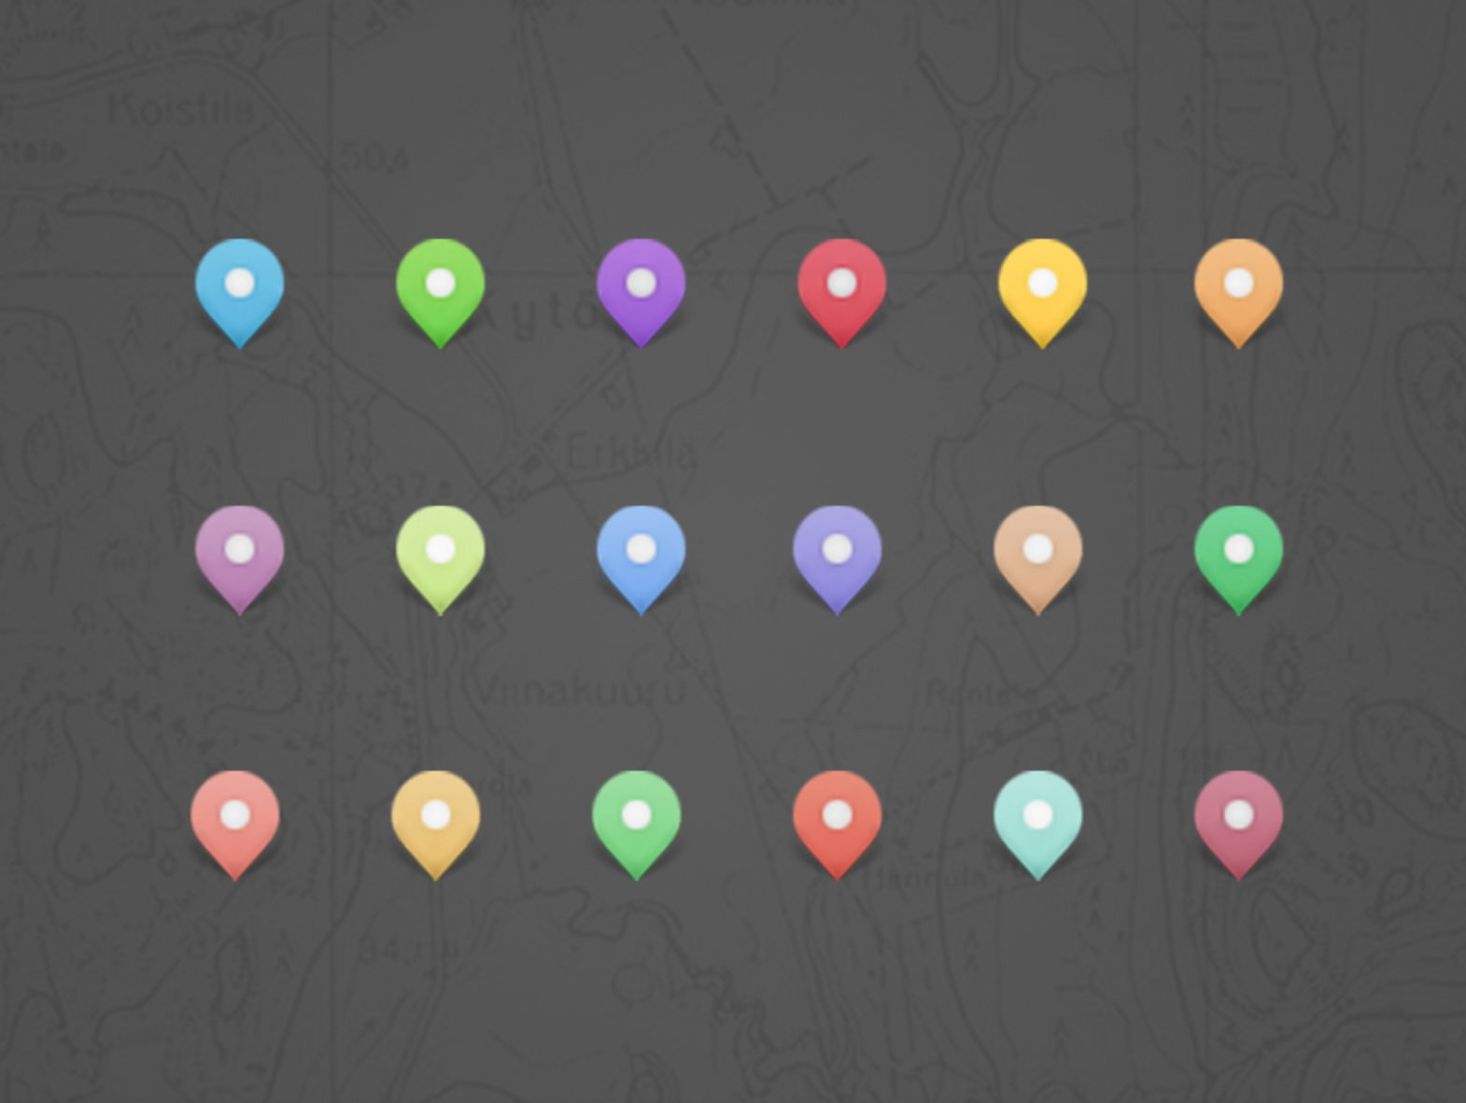
Communicating information with only colour
Image: Map Pins by Risha Egart. Dribbble.
Image: Parking map pins by Florent Lenormand. Dribbble.
Image: Project Markers by Neal Ellis. Dribbble.
Notes:
On the web common examples include link text, correct/incorrect information communicated in green/red.
Make sure you also have a secondary indicator, this will be helpful to user who are colour blind, or have low vision, and also to users who might be using screens with poor colour resolution, looking at contant in poor lighting, etc.

Slide 25
EXAMPLE

Slide 26
Example: brochure
Image: Ease Booklet by Kyle Anthony Miller. Dribbble.
Notes:
Good: Layout, leading, contrast, line length, amount of white space,
Could be better: tracking, font choice (character ambiguity), font weight, blue underline under paragraph text, data visualization

Slide 27
Donut charts that don’t rely only on colour
Image: Transacation Charts/Graphs by Michael Szczepanski. Dribbble.
Image: Animated SVG arc graph by Florent Peter Barr. Dribbble.
Notes:
A few ways in which the donut chart like the one in the example could be made more accessible.
Add category and percentage information pointing to the different slices: will work for charts with few categories. Not advised if you have more than 4-5.
Add a table with a visual legend, categories, and percentages next to the chart. This would be a better approach for brochure example due to the number of categories.

Slide 28
MULTIMEDIA

Slide 29
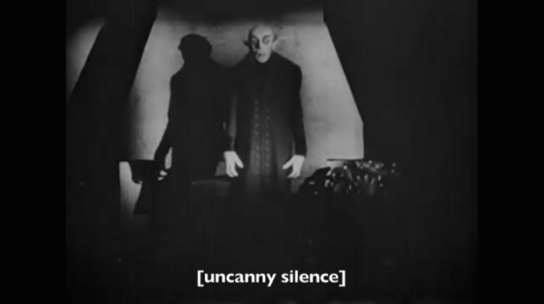
Videos: captions
Notes:
For any video material, include a captions track that captions speech, as well as other auditory information such as music, sound effects, paralanguage (screams, laughs), and manners of speaking (whispers, yells).

Slide 30
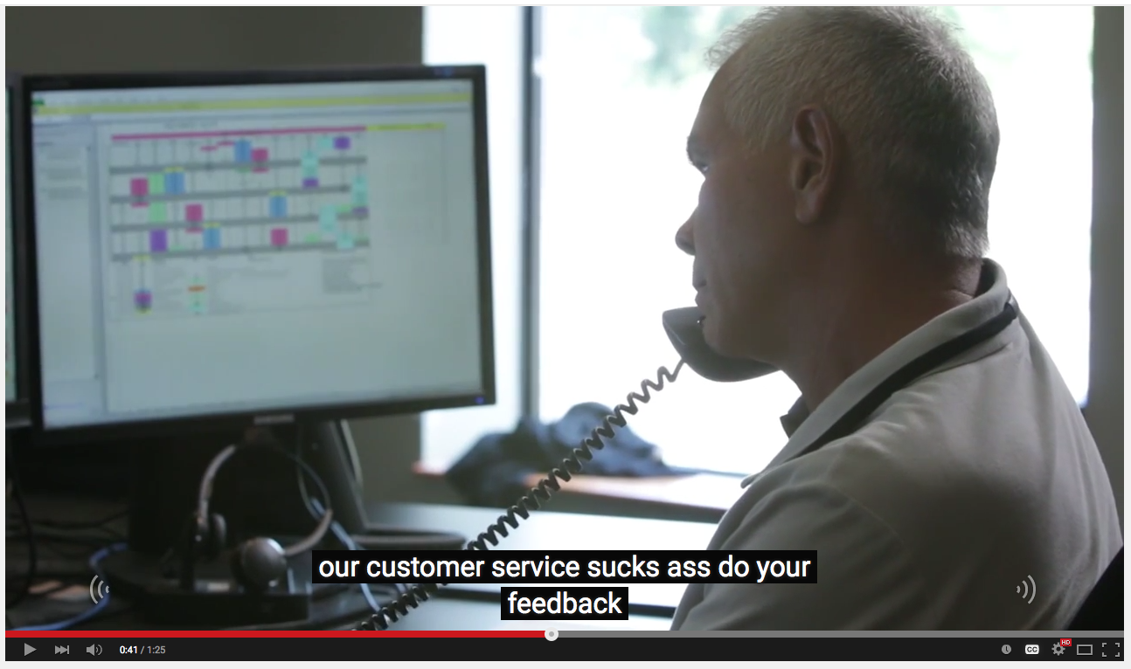
Beware of automated captions
“Our customer services success…”

Slide 31
Captioning best practices
Accurate (verbatim, spelling, in sync)
Consistent (styling, line length)
Up to 2 lines, 32 characters per line
Broken up at logical breaking points
Include important non-speech information

Slide 32
Videos: descriptive transcripts
Image: Vermette (iStockphoto)
Notes:
Captions and transcripts are for different audiences. Captions for those who can’t hear, but can see visual information. Transcripts for those who can’t see, and those who are deaf-blind (they can access the content via a braille display). So different considerations apply.

Slide 33
DIGITAL DOCUMENTS

Slide 34
Semantic content
Notes:
We can gather a lot of information about the role of different pieces of content based on visual cues. By looking at the example above we can quickly tell if something is a heading, paragraph, list or images.

Slide 35
Semantic content
Notes:
When non visual users perceive the content, this infomration needs to be semantically, or “programmatically’ defined, so that it can be communicated to assistive technologies. Imagine if you just heard all of the content on a page in a row without knowing whether something is a heading, a caption, or an image description.

Slide 36
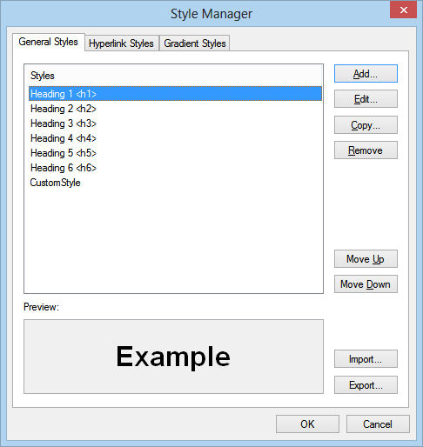
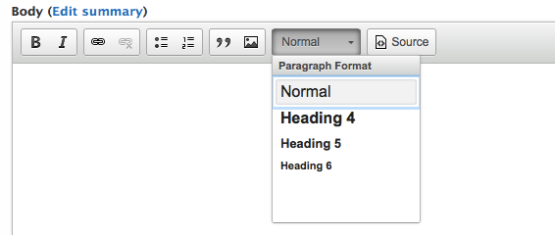
Style vs. styling
Notes:
This is why it’s important to understand the difference between styling– making something look like a heading (for example making it big, bold, different colour, etc.) And assigning a style to text. If you assign a style, whether that’s a heading level or list, this information is also encoded semantically, so that non-visual users also have access to this information.

Slide 37
Heading structure
Notes:
Avoid having different heading levels that are too similar to eachother. If headings (say h2 and h3) are of similar size, add another differentiator like colour, luminosity, underline, font.
The visual presentation should be the same as the semantic order. Avoid choosing a particular heading level from Style menus based on what it looks like instead of it’s semantic order. You can always modify the presentation of the heading to match the visual style you want.

Slide 38
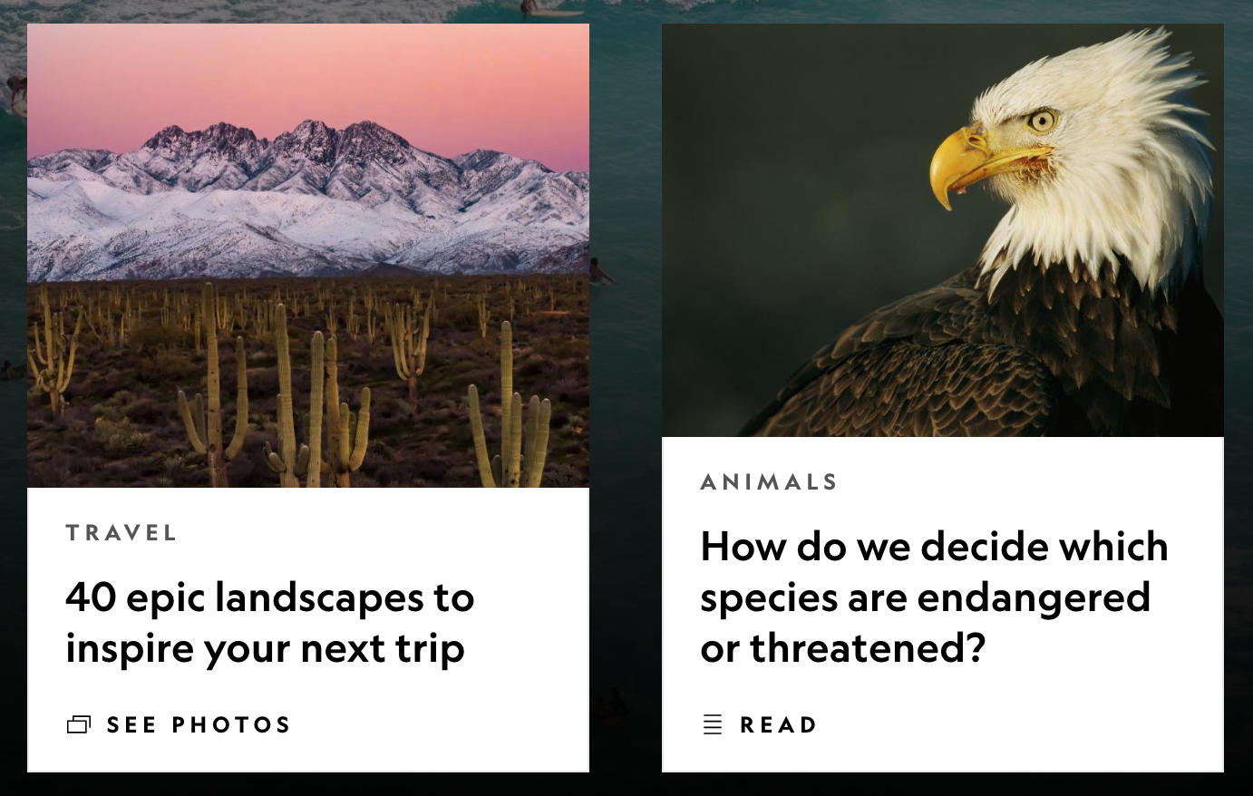
Add meaningful alternative text to images
Image: National Geographic. Home page.
Notes:
Does the image provide additional content? If it doesn’t, allow users to skip over it by marking it as a decorative element. If the image is not purely decorative, describe the image itself. Often images that are associated with articles and features have an alterative description that is identical to the heading that follows. This both fails to describe the image itself, and is redundant for the user since they end up hearing the information twice.
In the examples on the slides, the alt text descriptions should be something along the lines of “a field of cacti in front of a snowy mountain”, and a “bald eagle”

Slide 39
Set the document language
Notes:
Whether it’s a Word, PDF or HTML doc, make sure you define the document language, assistive technologies rely on that information for pronunciation, while visual browsers use it to display characters and correctly.
Image: https://www.ausbt.com.au/reviewed-five-language-learning-apps-for-your-smartphone

Slide 40
WORKFLOW

Slide 41
Workflow: integration is key for adoption!
You can help your organization by providing:
Accessible branded templates.
Accessible named styles with fonts, colours and text size encoded in.
An art and photo collection with accessible text alternatives.

Slide 42
Workflow: spread accessibility responsibilities
Everyone should be familiar with accessibility considerations: designers, content creators, managers.
Determine who has the responsibility to:
Add accessibility into documents in the first place (e.g. create templates)
Review the accessibility of documents
Address any remaining accessibility issues

Slide 43
Thank you!

